Slide 1
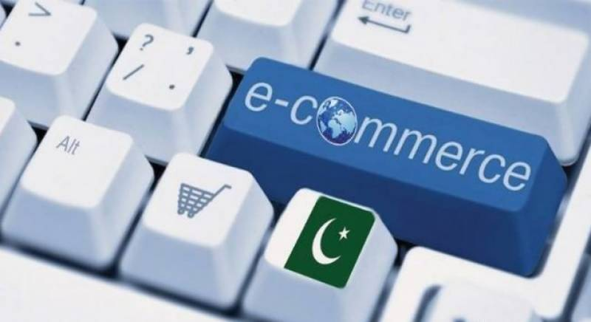
E-Commerce Policy Framework of Pakistan
Ministry of Commerce & Textile,
Commerce Division
4th February,2019.

Slide 2
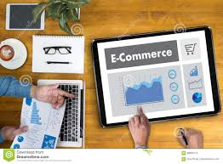
E-Commerce,Global Perspective

Slide 3
What is E-Commerce
It is the "production, distribution, marketing, sale or delivery of goods and services by electronic means”.
(As defined by the WTO)
The Internet of Things (IoT),Artificial Intelligence (AI) 3D printing & Blockchain technologies have the potential to further transform the global trade.

Slide 4
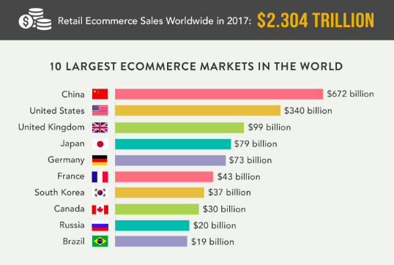

Slide 5
E-Commerce Potential of Pakistan
Continuously flourishing
Local E-Commerce Sales stood at Rs 9.8 Billion by the end of June 2017.(SBP)
Transactions worth Rs 20.7 billion were carried out by consumers on international e-commerce websites.(SBP)

Slide 6
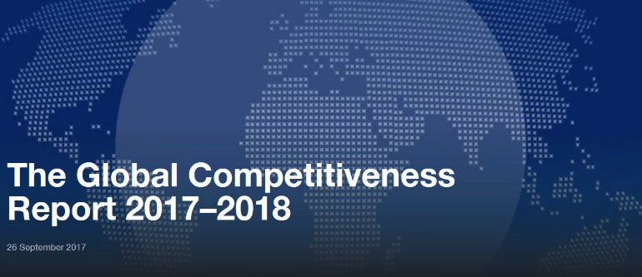

Slide 7
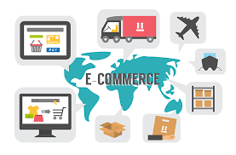
E-Commerce Policy Framework of Pakistan

Slide 8
Critical areas to be covered in the Framework
Consumer Protection
Dispute Resolution Mechanism
Licensing and registration requirements
Taxation
Payment Gateway
Privacy and Personal Data Protection
Multilateral Disciplines on E-Commerce
Promotion of SMEs trough e-Commerce

Slide 9
What Has been done so far

Slide 10
National Advisory Council
MoC Policy Unit (ECPU)
Taxation
Logistics
Payment
Regulatory
WTO
Policy Board

Slide 11
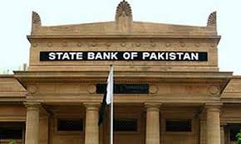
How SBP defines E-Commerce
1). Online marketplaces:
Act as intermediaries to various sellers and buyers,
helping lower search and transaction costs and expand reach of the businesses and choice for consumers.
Daraz.pk and Mega.pk, food panda
2). Online information and financial intermediaries:
Serve to fill the information gap and mostly earn profits through contract making and commission fees.
PakWheels, Rozze.pk, and Zameen.com

Slide 12
How SBP defines E-Commerce
3).Electronic Transportation Firms:
provide ride hailing and car pooling services through internet channels such as a mobile app.
Careem, Bykea, Uride,Uber
4).Social Media Based Sellers:
These players are either one-to-many or many-to-many stores.
operate purely though social media platforms like Facebook and Instagram.

Slide 13
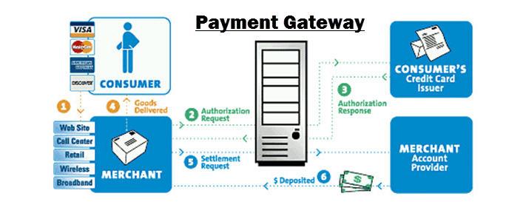
Tasks assigned to SBP
Payment Gate way (Pay pak ,operational for domestic payments).
Standardized Merchant on Board Criteria.

Slide 14
FBR defines Online Market Place
“It is an information technology platform run by an e-commerce entity over an electronic network that acts as a facilitator in transactions that Inserted by the Finance Act, 2017 occur between a buyer and a seller”. Section 2(38B).

Slide 15
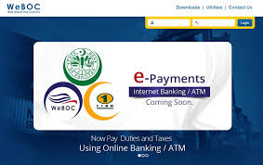
Tasks Assigned to FBR
Make WeBoC operational
Resolve Taxation issues with the Private Sector
Set a Deminimis Value
Allow re-export of items imported by consumers if the product is not as advertised or incorrect, subject to the conditions.

Slide 16
Proposals by the Private Sector
Ten year exemption from Sales Tax across all provinces
After ten year of tax holiday, a subsidized rate of 5% sales tax across all provinces on local sales
Withholding Tax exemption for E-Commerce
Commission revenue earned through export sales be exempt from Provincial Sales Tax
Provincial Taxation laws need to be harmonized to avoid double taxation

Slide 17
Taxes Applicable on Online Market Places
Revenue Authority | Taxes Applicable |  | Revenue Generated in last 3 years (in RS)
 |  | 2018-2019 | 2017-2018 | 2016-2017 | 2015-2016
Punjab Revenue Authority | Sales Tax @16% | 24,403,418 | 150,721,015 | 24,403,418
Sindh Revenue Board | Sales Tax @ 13% |  | 175,130,469 | 122,975,991 | 71,003,377

Slide 18
E-Commerce in other countries

Slide 19
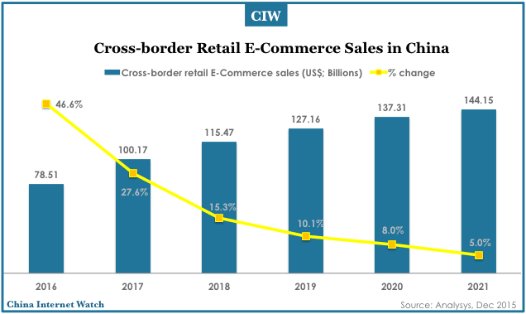
Some facts about Chinese E-Commerce Industry
E-Commerce in China represents approximately 35% of the overall retail market.
it is a global leader, China's E-Commerce share is expected to reach half of the global market by 2020.

Slide 20
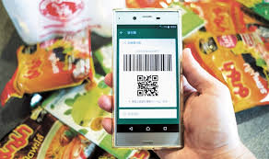
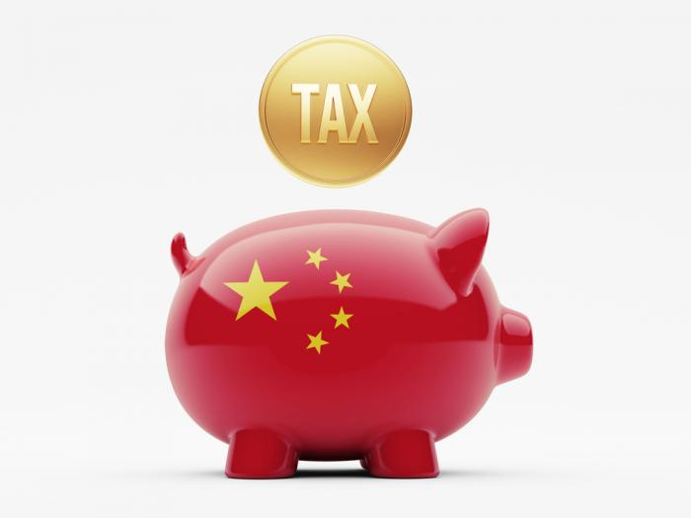
What China is doing? Contd…
Financial solutions ,payment through wallets such as Alipay, Wechat pay.
Automatic Payment through mobile Wallet by scanning the QR Code.
Establishment of ware Houses for Import & Export.

Slide 21
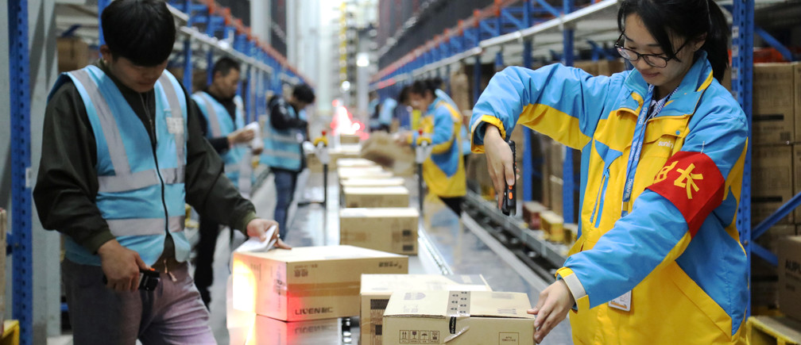
What China is doing?
Wide scale Internet Connectivity
Supportive laws and Relaxed Regulatory mechanism
Public Private Partnership
Training of SMEs by AliBaba

Slide 22
E-Commerce In India
Encouragement &Training of SMEs through:
Digital India
Make in India
Skill India
Introduction of changes in E-Commerce policy to protect small vendors & provide level playing field to all online merchants.

Slide 23
Enabling Environment for E-Commerce in Pakistan

Slide 24
Paypak is Facilitating domestic E-Payments
WeBOC is Operational for traders .
Optic fiber cables are being arranged for better speed and connectivity
Better Logistic services are being offered by Pakistan Post
Digital Pakistan Policy is formulated by Ministry of IT & Telecom
Data Protection Bill is being drafted by Ministry of IT & Telecom
Private Sector is ready to Join hands with the Public Sector.

Slide 25
Way forward

Slide 26
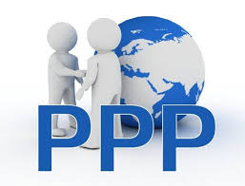
1).Public Private partnership
Create an enabling environment that empowers SMEs for trade
Skill Development of SMEs for digital presence
Promotion and creation of Fintech solutions such as mobile wallets
Merchant on board account
Infrastructure development and increase of internet users

Slide 27
Way forward
2).Need for third party trusted services to address consumer protection
3).Promotion of digital marketing and use of influencer marketing techniques
4).Favorable tax regime to attract domestic and foreign investment for making Pakistan a competitive e -commerce player
5). Promotion of the IT enabled logistics systems of logistics operators.

Slide 28
Thank You

