Slide 1
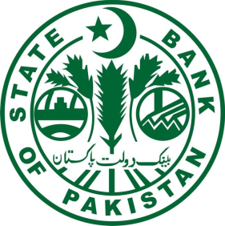
Presentation on Initiatives Identified for E-Commerce Merchants

Slide 2
Content
Enhancement in non-banking players for merchants
Simplified Merchant Onboarding
Increase in merchant acceptance points (QR)
Infrastructure
Cyber Security

Slide 3
Enhancement in Non-Banking players for merchants

Slide 4
Why Regulations for EMIs?
Negligible participation of non-banks in Payments landscape
Lack of focus of banks on digital payments/ infrastructure – Low usage of digital payments particularly in sub-urban and rural areas
FinTechs have potential to bring disruption in payments in Pakistan
Regulations will promote competition among banks & non-banks in payments landscape

Slide 5
Objectives of E-Money Regulations
To provide a Regulatory framework for prospective e-money payment service providers in order to facilitate their entry in the payments landscape of Pakistan as per international best practices
Will facilitate escrow arrangements which will promote e-commerce
Status
The guidelines are at the approval stage. It is expected that the same will be issued during current FY.

Slide 6
Guidelines for Digital Merchant Onboarding

Slide 7
Background
Recommendation by E-Commerce Policy Committee on Payments Infrastructure Chaired by Director, PSD
Less digital payment acceptance points
  POS machines have hovered around 50k for many years

Slide 8
Objective of Guidelines
Under the guidelines, SBP is introducing a new category of digital merchants for push and pull based transactions
Banks can now onboard merchants based on tiered Know Your Customer (KYC) requirements and sales per month.
The digital merchants shall be allowed to accept push and pull based payments transactions such as QR, IBFT, plastic cards, wallet to wallet transfers, NFC etc.
Status
The guidelines are at the approval stage. It is expected that the same will be issued during current FY.

Slide 9
Increase in Merchant Acceptance Points (QR)

Slide 10
QR In Pakistan
QR Payments are picking up pace due to lower cost
  Estimated that more than 100,000 QR are deployed in Pakistan
Although majority of QRs in Pakistan are based on EMV Co. Standards, they lack interoperability
Solution
Complete EMVCo standard based QR generation (at both ends)
  Capability to scan and process QR issued by other players
SBP is mandating standardized QR Generation, based on complete EMV Co. specifications
Status: Circular to be issued by this month.

Slide 11
Infrastructure

Slide 12
Micro Payment Gateway (MPG)
A simple, secure and innovative payment solution for people of Pakistan MPG will allow individuals to make any payment digitally, in a simple, fast, low cost, irrevocable and secure manner

Slide 14
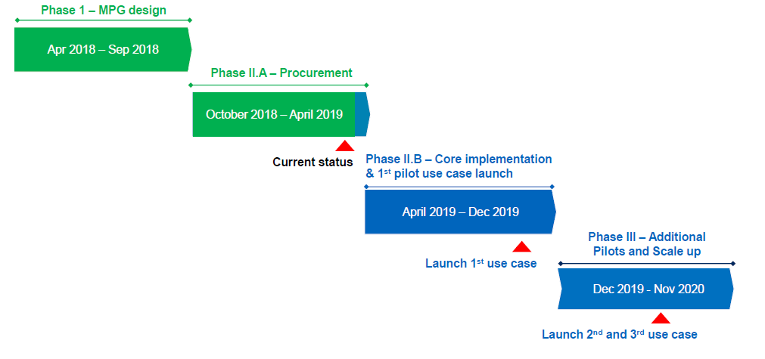
Status

Slide 15
Cyber Security

Slide 16
Initiatives
PSD Circular No. 09 of 2018 on Security of Digital Payments
SBP’s instructions with regard to safety and security of digital transactions
Failure to comply with the above instructions will lead to penal action by SBP such as suspension of non-compliant digital payment products and services of the banks/MFBs

Slide 17
Thank you

